Slide 1

DEPARTMENT OF COMPUTER SCIENCE AND ENGINEERING
Project name : Environmental Monitoring
Team name : Proj_224786_Team 5
Team members :
JEEVAN SIVA SANKAR A (113321205021) SELVA KUMARAN T (113321205046) SRIDHAR B (113321205051) SABAREES S (113321205301)

Slide 2
PROJECT:
Smart Environmental Monitoring is an IoT and AI-enabled governance platform that empowers Urban Local Bodies and schools to enhance the quality of environmental monitoring and standardize data collection. Developing a smart environmental
monitoring system using IoT (Internet of Things) entails a fusion of hardware, software, and connectivity. Although web development technologies may not be the sole necessity, they can play a pivotal role in creating a user interface for overseeing and managing the smart environmental monitoring system.

Slide 3
PLATEFORM REQUIRED:
Environmental Monitoring Hardware: Various environmental sensors and monitoring devices are essential for data collection in the field of environmental monitoring. These may encompass air quality sensors, water quality analyzers, temperature and humidity sensors, and more. These devices are responsible for gathering data related to environmental conditions.
Environmental Data Communication Protocols: To facilitate the transfer of data from these environmental monitoring devices to data collection centers, communication protocols like MQTT, CoAP, or HTTP(S) are utilized for seamless data transmission.
3. Microcontrollers and Environmental Monitoring Boards: Microcontroller platforms like Arduino, Raspberry Pi, or specialized environmental monitoring boards serve as the control and management units for the environmental monitoring devices, ensuring data accuracy and reliability.
Internet Connectivity: A stable and reliable internet connection is imperative for environmental monitoring systems to transmit and receive data. This connection can be established through Wi-Fi, Ethernet, or cellular connectivity, depending on the monitoring location.

Slide 4
WEBDEVELOPMENT TECHNOLOGIES:
Front-End: You can use HTML, CSS, and JavaScript for creating a web based dashboard or user interface. Frameworks like React, Angular, or Vue.js can simplify the development process
Back-End: You might need a server to handle data processing, user authentication, and other backend functionalities. You can use Node.js, Python, Ruby, or any other server side technology.
Databases: Use databases (e.g., MySQL, PostgreSQL, MongoDB) to store and retrieve data.
APIs: Create APIs to connect the front-end and back-end. RESTful or Graph QL APIs are common choices.

Slide 5
PROJECT REQUIREMENTS
Objective Definition:
Clearly define the goals and objectives of the environmental monitoring project. Determine what specific parameters or aspects of the environment you want to monitor.
Site Selection:
Identify the locations where monitoring will take place. Consider factors such as geographical diversity, ecosystem types, and proximity to potential sources of environmental stress.
Sensor Selection:
Choose appropriate sensors for monitoring the identified parameters. Common environmental parameters include air quality (particulate matter, gases), water quality, soil moisture, temperature, humidity, and noise levels.
Data Accuracy and Precision:
Ensure that the selected sensors provide accurate and precise measurements. Calibration and regular maintenance of the sensors are crucial to maintaining data integrity.
Data Transmission:
Decide on the method of data transmission. It could be wired or wireless depending on the project requirements and the accessibility of the monitoring sites.

Slide 6
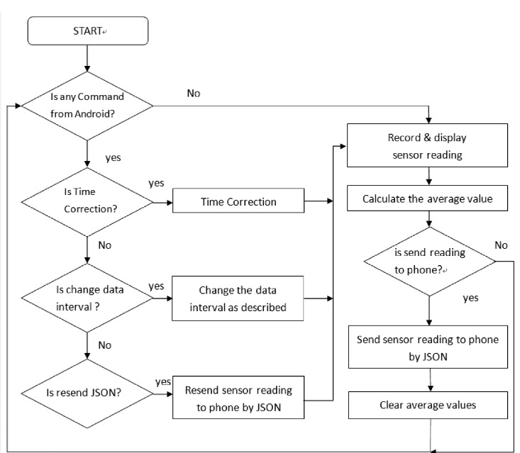

Slide 7
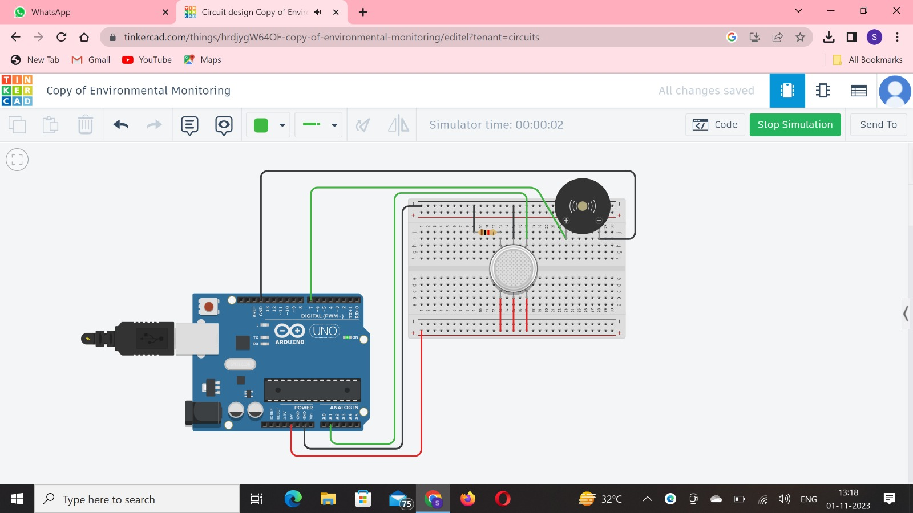

Slide 8
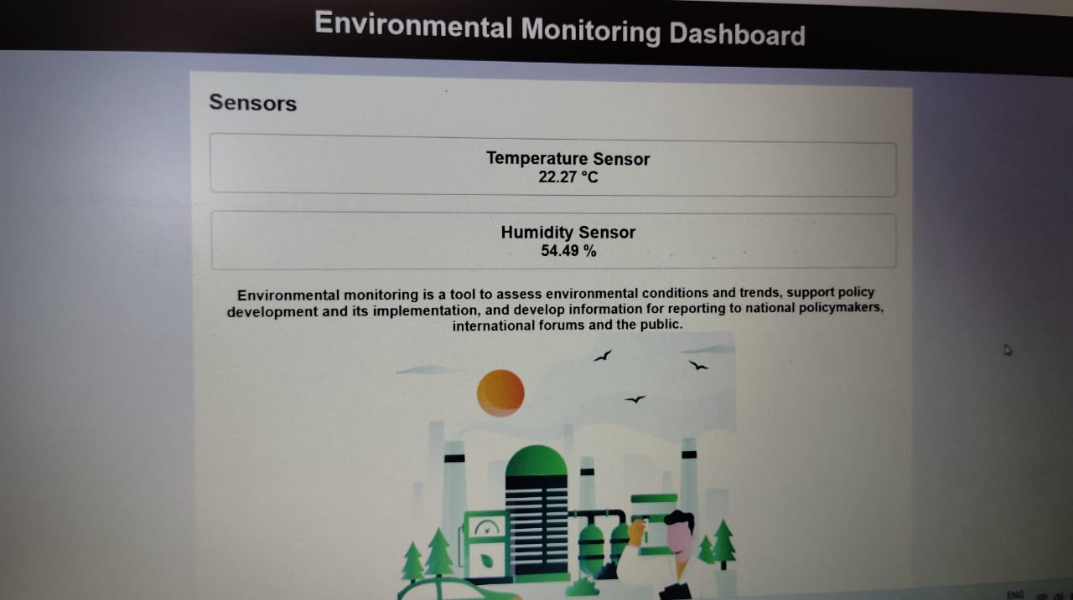
Click here to view code on GitHub
Click here to view my website

Slide 9
Thank you

